Slide 1









TEXT ANALYTICS MSBA Fall 2019 Session 2, 10/23, 10/24
Dr. Anitesh Barua
David Bruton Jr. Centennial Chair Professor of Business
Distinguished Fellow, INFORMS Information Systems Society
Stevens Piper Foundation Professor
University of Texas Distinguished Teaching Professor
McCombs School of Business, University of Texas at Austin
Email: aniteshb@gmail.com

Slide 2
Knowledge Discovery & Insights from User Generated Content
User generated content (UGC) can reveal new insights about brands, products & events
The idea
Find out what people are talking about
Find key entities (e.g., brands, products, etc.) & attributes (e.g., service, price, etc.)
Find associations between words
Visualize, correlate with business outcomes (e.g., switching)
Copyright Anitesh Barua 2019

Slide 3

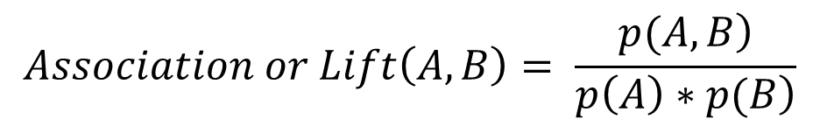
Co-occurrence of Terms
Do terms or words appear together in messages by chance or due to real association?
E.g., is Volvo more likely to mentioned in conjunction with safety related words than Toyota?
Is Honda more likely to be associated with reliability than, say, Jaguar?
$$Let A and B represent two words or phrases$$
$$E.g., A=Volvo, B=safety$$
$$Association or Lift\left(A,B\right)= \frac{\left.p(A,B\right)}{\left.p\left(A\right)∗p(B\right)}$$
$$where p\left(A,B\right) is the probability of both A \& B appearing in a message$$
$$where p\left(A\right) is the probability of A appearing in a message$$
$$where p\left(B\right) is the probability of B appearing in a message$$

Slide 4
Interpretation of Lift
Lift can be = 1, > 1 or < 1
What does it mean when Lift(A,B) = 1?
What about Lift (A,B) > 1?
What is the significance of the word Lift in this context?
What about Lift(A,B) < 1?
From a practical standpoint we don’t distinguish between Lift(A,B) = 1 or < 1

Slide 5
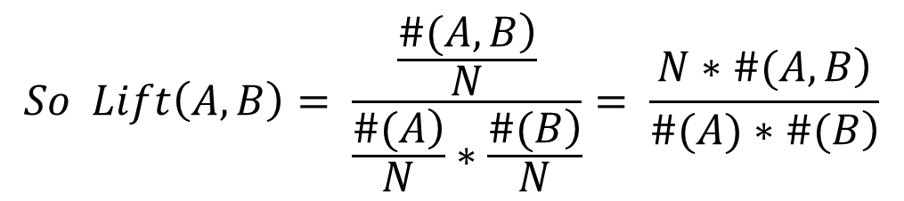
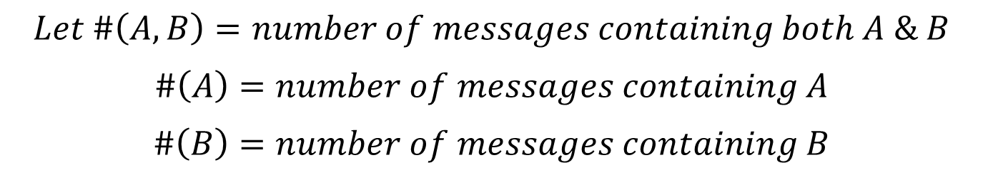
An Frequentist Interpretation of Lift
$$Let \#\left(A,B\right)=number of messages containing both A \& B$$
$$\#\left(A\right)=number of messages containing A$$
$$\#\left(B\right)=number of messages containing B$$
$$Then p\left(A,B\right)=\frac{\left.\#(A,B\right)}{N}, p\left(A\right)= \frac{\left.\#(A\right)}{N}, p\left(B\right)= \frac{\left.\#(B\right)}{N}$$
$$So Lift\left(A,B\right)= \frac{\frac{\left.\#(A,B\right)}{N}}{\frac{\left.\#(A\right)}{N}∗\frac{\left.\#(B\right)}{N}}= \frac{\left.N∗\#(A,B\right)}{\left.\#(A)∗\#(B\right)}$$

Slide 6









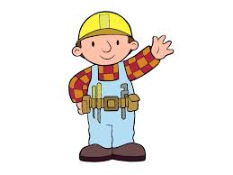

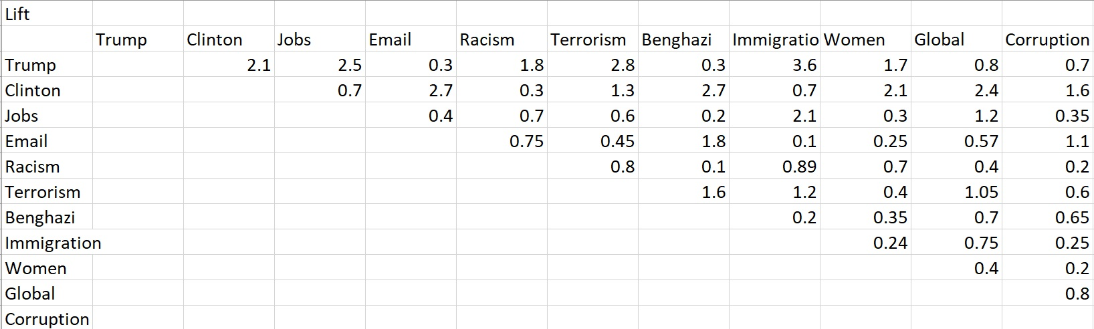
Which Associations are Strong?
?
Copyright Anitesh Barua 2019

Slide 7
An Example from Edmunds.com
 | Toyota Camry | Volvo S40
# mentions | 34,559 | 1160
# co-mentions with safety related words | 379 | 60
Lift of make/model & safety related words
Total # messages: 868,174 (assume one make/model
appears only once in a message
Safety related messages: 4534
What are the values of Lift(Volvo, safety) and Lift(Toyota, safety)?

Slide 8
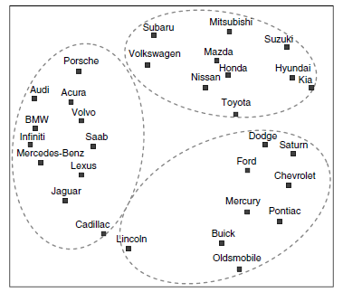
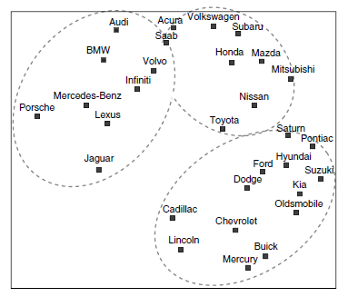
Can We Predict Switching Behavior?
Forum co-mentions
(100k mentions)
Actual brand switching
(3.5 million)

Slide 9
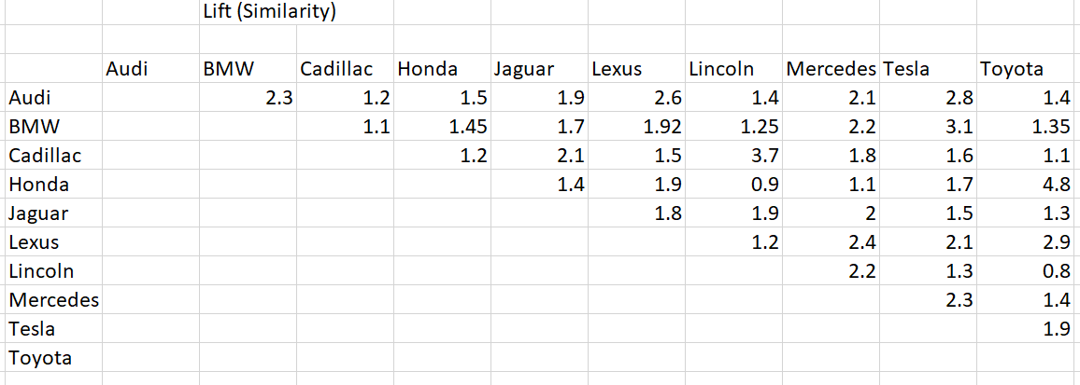
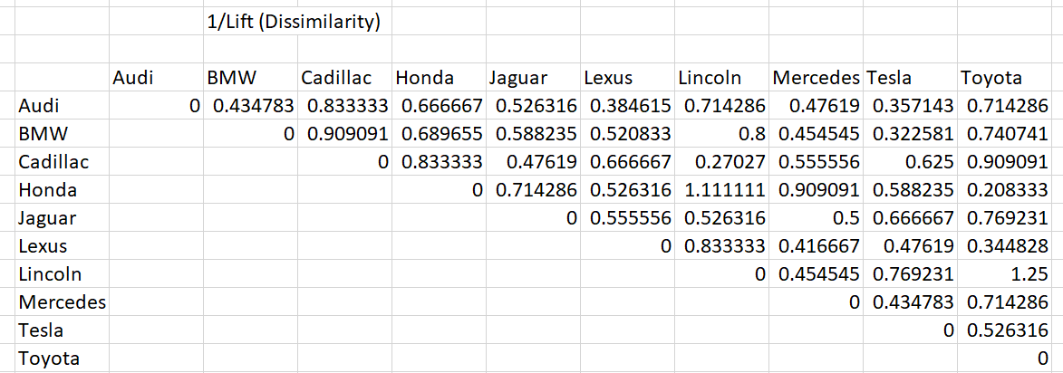
How to Draw an MDS Plot
Should we plot the lift values directly?
Copyright Anitesh Barua 2019

Slide 10
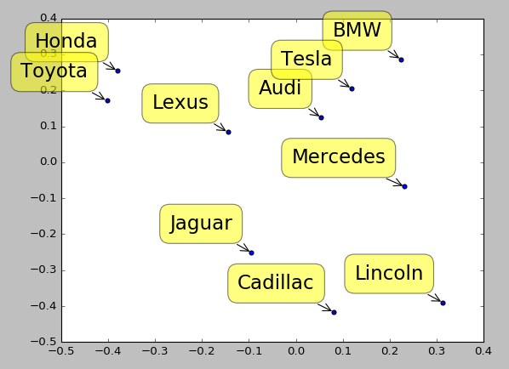
What do the MDS Axes Represent?
Copyright Anitesh Barua 2019

Slide 11
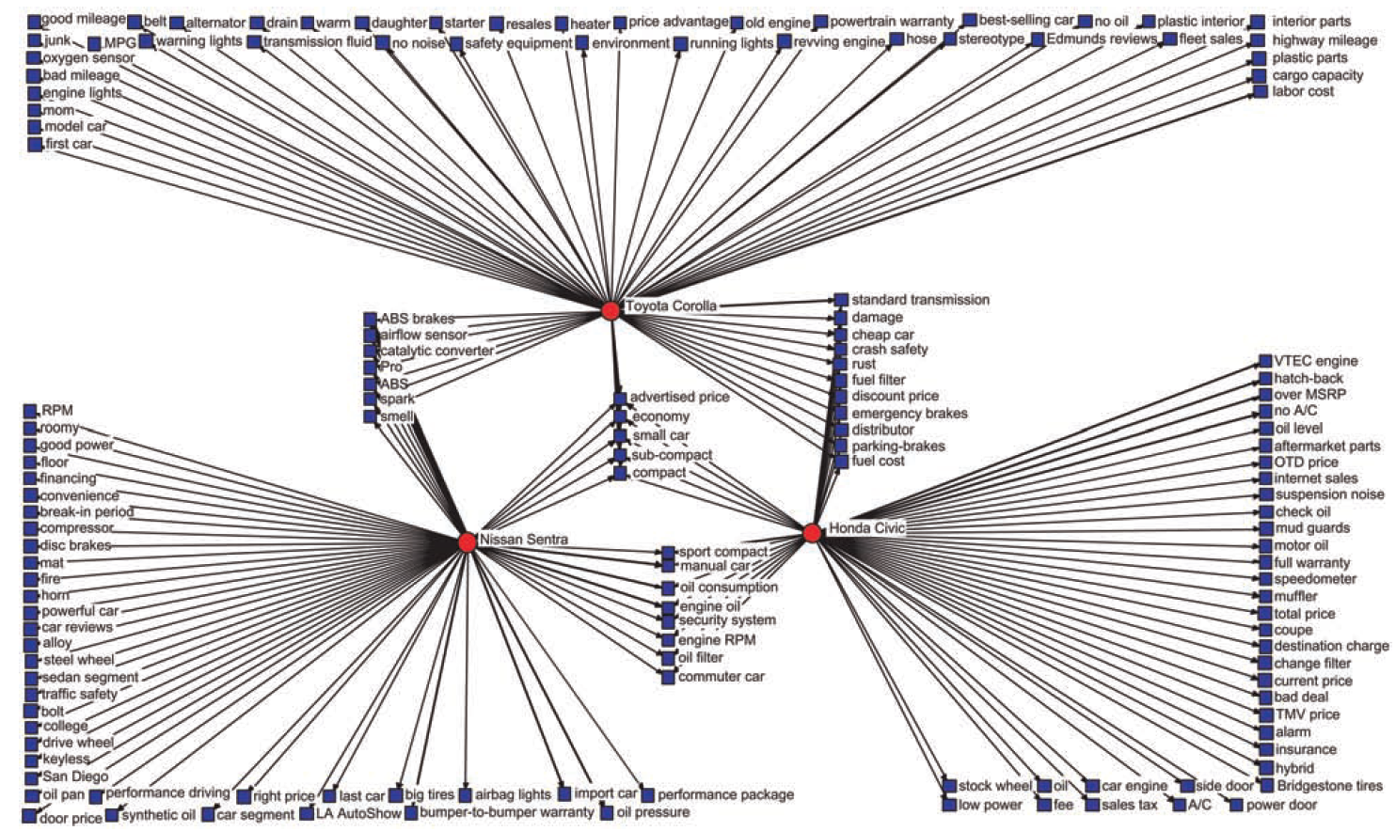
Product Attribute Associations

Slide 12
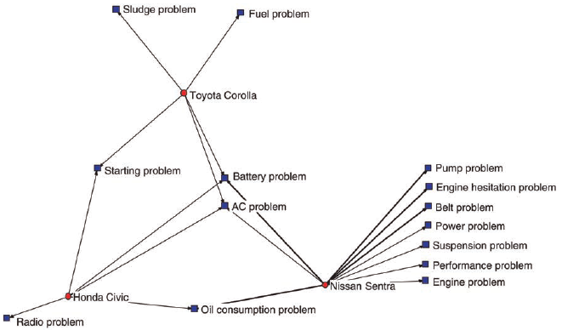
Negative Perceptions

Slide 13
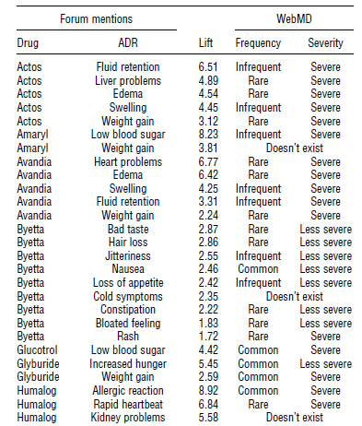
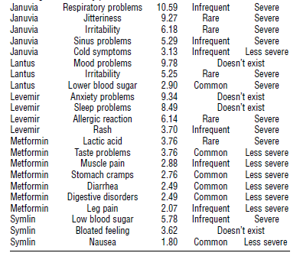
Crowds Vs. Experts

Slide 14
Beyond Pairwise Association
Do people compare Audi & BMW when they discuss performance?
Mentions
of Audi
Mentions
of BMW
#(A,B,P)
Mentions of
Performance
All Mentions

Slide 15
Conditional Lift
Lift(x,y|z) = P(x,y|z)/[P(x|z)*P(y|z)]
= [#(x,y,z)/#(z)] / [{#(x,z)/#(z)}*{#(y,z)/#(z)}]
= [#(x,y,z)*#(z)] / [#(x,z)*#(y,z)]
E.g., L(Audi, BMW|performance) =
[#(Audi, BMW, performance)*#(performance)] / [#(Audi,performance)*#(BMW,performance)]
Perf: 500; Audi & perf: 250; BMW & perf: 300; Audi, BMW & Perf: 200
L(A,B|P) = (200*500)/(250*300) = 1.33

Slide 16
How is Lift Different from Confidence?
Commonly found in commercial software packages
n% of people who mentioned word x (e.g., BMW) also mentioned y (e.g., Lexus)
Confidence(Lexus|BMW) = #(Lexus,BMW)/#(BMW) = (say) 125 / 300 = .417
Confidence is not symmetric
Also if most people talk about Lexus anyway, Confidence(Lexus|BMW) will not be a useful metric.
Copyright Anitesh Barua 2019

